Slide 1
Employee Data Analysis using Excel
STUDENT NAME: PRAVEEN KUMAR K
REGISTER NO: 312203705 ,NM ID: 32265A96464906CB1364AC35666673C2
DEPARTMENT: BCOM( COMPUTER APPLICATIONS)
COLLEGE: HINDUSTAN COLLEGE OF ARTS AND SCIENCE

Slide 2
PROJECT TITLE
Employee Performance Analysis using Excel

Slide 3


AGENDA
Problem Statement
Project Overview
End Users
Our Solution and Proposition
Dataset Description
Modelling Approach
Results and Discussion
Conclusion
3/21/2024 Annual Review

Slide 4

PROBLEM STATEMENT
Organizations often face challenges in evaluating and managing employee performance due to fragmented or inconsistent data tracking methods. This project aims to design and implement an Excel-based performance analysis tool to streamline the evaluation process. The objective is to a comprehensive Excel workbook that integrates multiple performance metrics, such as productivity, punctuality, and quality of work, into a cohesive system. This tool will enable users to input, track, and analyze performance data effectively, generate visual reports, and identify trends or areas for improvement. By leveraging Excel’s functionalities, including formulas, pivot tables, and charts, the project seeks to provide an accessible and actionable solution for performance management.

Slide 5

PROJECT OVERVIEW
Objective: Evaluate employer performance to identify strengths, weaknesses, and improvement areas.
Scope: Collect and input performance data.- Analyze data using Excel functions and tools.- Create visualizations and reports for insights.
1. Data Collection: Gather and organize performance data.
2. Data Input: Enter data into Excel.
3. Analysis: use formulas and pivot tables to analyze performance metrics.
4. Visualization: Create charts and graphs for data interpretation.

Slide 6

WHO ARE THE END USERS?
The end users of the employer performance analysis project are typically:
1.HR Managers: They use the analysis to assess overall employee performance, make decisions about promotions, terminations, and professional development.
2.Executives and Senior Management: They use the insights to guide strategic decisions, allocate resources, and align performance with organizational goals.
3.Performance Review Committees: They may use the data to support performance evaluations and ensure consistency in assessments.
4.Employees: Indirectly, they may benefit from the analysis as it can lead to more tailored feedback, development opportunities, and fairer evaluations.

Slide 7

OUR SOLUTION AND ITS VALUE PROPOSITION
FORMULAS- TO CALCULATE PERFORMANCE AUTOMATICALLY BASED ON RATINGS OF THE EMPLOYEES
CHARTS- USED CHARTS TO REPRESENT THE DATA VISUALLY FOR A BETTER UNDERSTANDING AND COMPARISON OF DATA.
FORMATTING- TO DELETE EMPLTY CELLS.
FILTERS- TO REMOVE UNNECESSARY DATA.

Slide 8
Dataset Description
Data Set Description for Employer Performance Analysis
1. Employee ID: Unique identifier for each employee.
2. Employee Name: Full name of the employee.
3. Department: The department or team to which the employee belongs.
4. Position/Role: The job title or role of the employee within the organization.
5. Performance rating: performance rating On scale of 0-5(0-bad,1-ok,2-average,3-good,4-verygood,5-excellent).
6. Supervisor: supervising individual of an employee.
7.payzone.
8. gender.
9. Marital status

Slide 9
THE "WOW" IN OUR SOLUTION
WOW FACTOR IN THE PROJECT
Interactive Dashboards: Create dynamic dashboards with charts, graphs, and slicers that allow users to interact with the data and gain insights quickly. Advanced
2 . Data Visualization: Use sophisticated charts, such as heat maps, spark lines, and bullet graphs, to present performance metrics in a visually compelling way.
3. Automated Reports: Implement automation with Excel formulas and macros to generate performance reports at the click of a button.
3/21/2024 Annual Review
9

Slide 10
MODELLING
1.DOWNLOADED A EMPLOYEE DATA SET FROM“ WWW.KAGGLE.COM”.
2. DELETED EMPTY CELLS.
3. REMOVED UNECESSARY ROWS AND COLUMNS.
4. USED FORMULA (=SWITCH) TO EVALUATE REVIEW IN ACCORDANCE WOTH RATING.
5. USAGE OF GRAPHS AND CHARTS FOR A BETTER UNDERSTANDING.
10

Slide 11
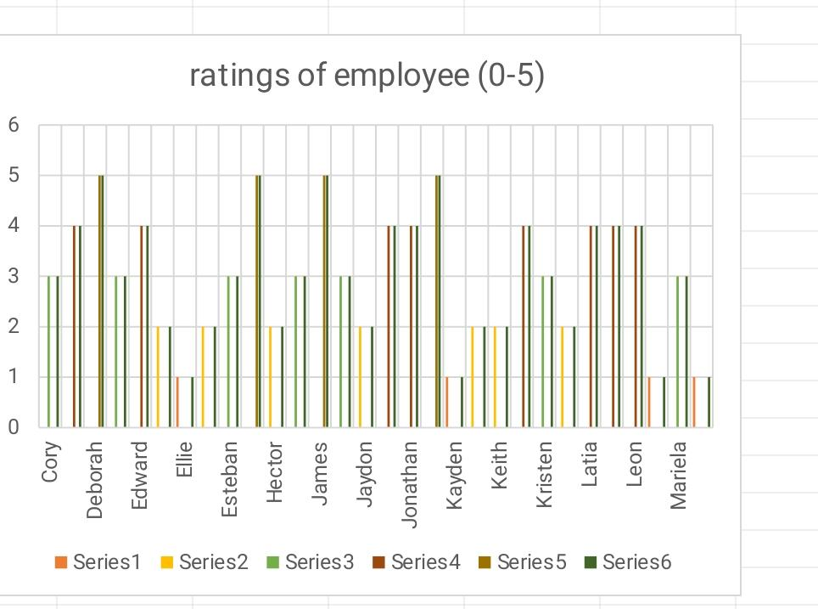
RESULTS
11

Slide 12
conclusion
In summary, analyzing employee performance is essential for driving both individual and organizational growth. By regularly reviewing performance, we can better understand our team's strengths and areas where improvement is needed. This not only helps in aligning individual efforts with company goals but also boosts overall productivity and job satisfaction. Going forward, let's use these insights to make informed decisions, support our employees' development, and keep our organization moving in the right direction.

